Slide 1
Subsidiary ICT for Uganda
Curriculum Topic 10 out of 15: ELECTRONIC PRESENTATION
Recommended Coverage Duration: 32 periods (5 ¹/₃ weeks)
Senior Five Term III
Notes:
Guidance to the Teacher
Introduce a class presentation project from the beginning and continue working on the project as the topic progresses
Emphasise correct use of images and text (font size and style) depending on the end users for whom the presentation is intended. The font size and type of images meant for a presentation to children is different from the presentation to adults.
You should prepare presentations for learners to critique and generate ideas on what a good presentation should be, with reasons.
You are advised to use demonstrations for each of the skills being introduced.
Give learners an opportunity to observe, and allow them to practise and develop the skills individually or in groups if the equipment allow. As much as possible, give each learner a chance to develop the skills in the topic.
Give assignments where learners prepare and deliver presentations to the rest of the class so that they can develop confidence in delivering a presentation.
Suggested Competences for Assessment
Assess the learners’ ability to create an informative presentation, deliver a presentation to an audience and customise a presentation to meet end user needs.

Slide 2
Background
Communicating effectively to a big audience is a challenge to many people. It should be noted, however, that versatility of ICTs has played a big role in enhancing the ease and impact of the presentation process.
A presentation programme is supposed to help both the presenter with a range of tools to clearly structure his ideas and offer the participants with multimodal information that is engaging. There are many areas where presentations are used. Some of these include professional (work-related), education, entertainment, and for general communication. Presentation programmes can either supplement or replace the use of older visual aid technology, such as pamphlets, handouts, chalkboards, flip charts, posters, slides and overhead transparencies.
There are a number of presentation software such as Microsoft power point, open office presentation, lotus freelance, Corel presentation, among others. Text, audio, graphics, movies and other objects are positioned on individual pages or slides in a given presentation. The "slide" analogy used in presentation software is a reference to the slide projector, a device that has become somewhat obsolete due to the use of better technologies.
Slides can be printed, or (more usually) displayed on-screen and navigated through at the command of the presenter. Transitions between slides and animation in each slide can be done in a variety of ways. Coming up with a good presentation requires a lot of input: planning, collecting information and constructing.
Learning Outcome: The learner should be able to create and deliver a multimedia presentation.

Slide 3
Presentation Outline
UACE Sub – ICT Topic 10:
Electronic Presentation
Sub Topic 10.1: Introduction to Electronic Presentation
Sub Topic 10.2: Working with Presentation Software
Sub Topic 10.3: Developing a Presentation
Sub Topic 10.4: Charts
Sub Topic 10.5: Graphical Objects
Sub Topic 10.6: Presentation Output
Sub Topic 10.7: Slide Show

Slide 4
Sub Topic 10.1: Introduction to Electronic Presentation
Sub topic Objectives:
Meaning of presentation
Examples of presentation software
Functions of presentation software
Purpose of a presentation
Principles of a good presentation.
Features of a presentation software interface
Application areas of a presentation

Slide 5

10.1.1 Meaning of presentation
Presentations usually involve a speaker conveying information to an audience.
Presentation software is used to organise and deliver presentations.
The presentation can be viewed as a slide show which usually displays on a monitor or on a projection screen.

Slide 6
10.1.2 Examples of presentation software
Popular presentation software include: Microsoft PowerPoint, Lotus Freelance Graphics, KPresenter, OpenOffice.org Impress, Corel Presentations, Celframe Power Presentation, Ability Presentation, Kingsoft Presentation, Apple Keynote, etc.

Slide 7
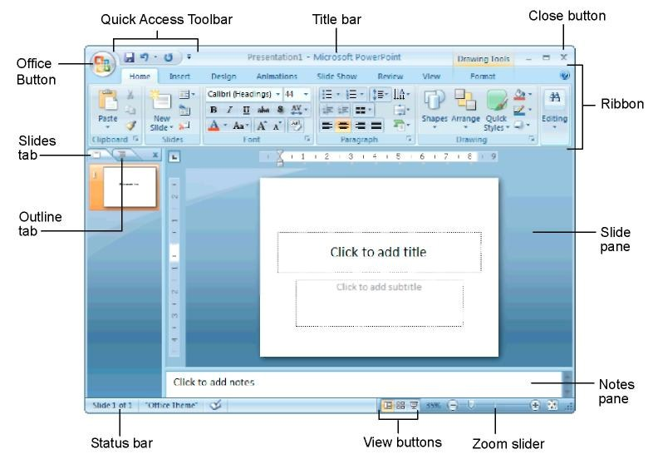
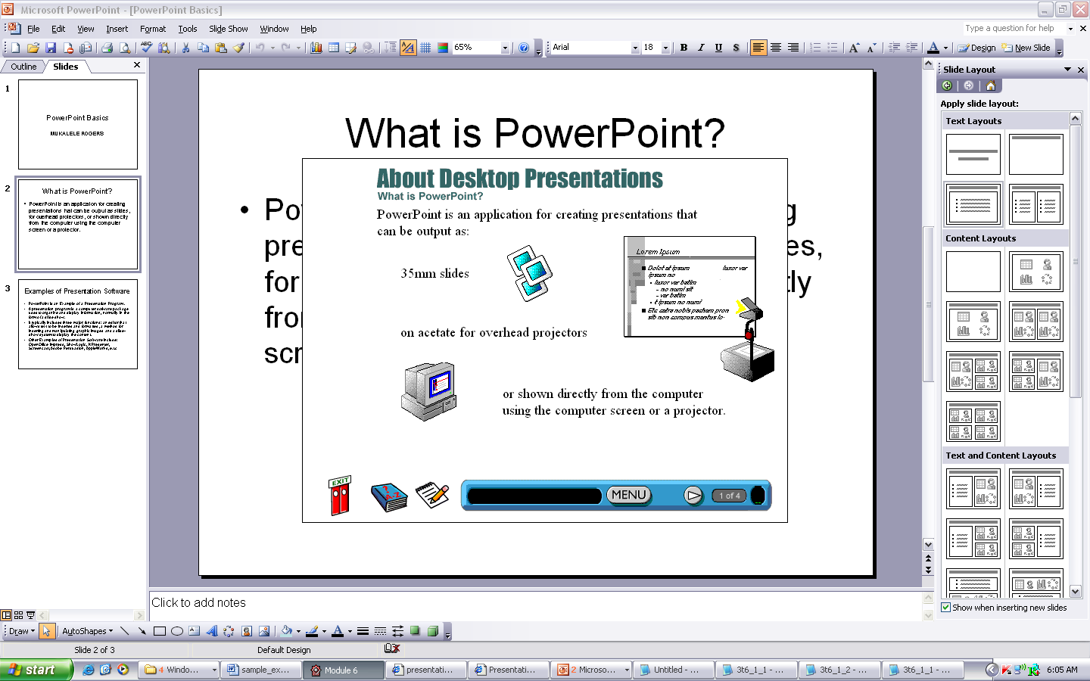
10.1.3 Functions of presentation software
Presentation software usually plays three major functions:
A slide editing that allows text and graphics to be inserted and formatted,
Inserting and manipulating animations and
A slide-show system to display the content.

Slide 8
10.1.4 Purpose & merits of electronic presentations
The main purpose of an electronic presentation is to act as an aid during a speech presentation in the following ways
It encourages and supports teaching learning process by displaying the content of the presentation.
Electronic presentations are usually fun to watch. They improve the audience’s learning motivation, increasing materials for study, encouraging interaction between the speaker and the audience.
Electronic Presentations can be saved in softcopy and reused in future.
Presentation software is able to perform a variety of manipulations, such as editing text before printing it out.

Slide 9
10.1.4 Purpose & merits of electronic presentations
Presentation software usually provides a wide variety of presentation formats and layouts for the slides to organise content appropriately.
Multimedia components such as clipart images, video clips and audio clips can be incorporated into the slides.
The timing of the slides can be set so that the presentation automatically displays the next slides / items after a predetermined period of time.

Slide 10
10.1.4 Purpose & merits of electronic presentations
However, using computer presentations can have the following drawbacks/demerits:
Equipment failure: Relying on electronic presentations can be frustrating in case the computer system sometimes does not work as expected during delivery. The speaker has to be prepared with alternative strategy, such as keeping printed hand-outs to use in case of such a failure or power blackout.
File Corruption: The presentation file can be damaged and fail to run.
Incompatible Media and devices: Some computers and projectors can not connect or work together, and the presenter has to do testing before hand.
Distractions: Some members of the audience may be distracted by the animations and graphics in the presentation instead of focusing on the content.

Slide 11

10.1.5 Principles of a good presentation
1. Keep it Simple
Don’t let your message and your ability to tell a story get derailed by slides that are unnecessarily complicated, busy, or jumbled. Do not feel compelled to fill empty areas on your slide with other unnecessary graphics or text boxes that do not contribute to better understanding. The less clutter you have on your slide, the more powerful your visual message will become.

Slide 12


10.1.5 Principles of a good presentation
2. Limit Text
Remember, the slides are meant to support the narration of the speaker, not to make the speaker redundant.
Try to avoid text-heavy slides like this one.
Aim for something simple like this slide.

Slide 13
10.1.5 Principles of a good presentation
3. Limit animations
Use slide animations sensibly. Some animation is a good thing, but stick to the most subtle and professional (similar to what you might see on the evening TV news broadcast).
A simple “Wipe Left-to-Right” (from the “Animations” menu) is good for a bullet point, but a “Move” or “Fly” for example is too tedious and slow (and yet, is used in many presentations today).
Listeners will get bored very quickly if they are asked to endure slide after slide of animation. For transitions between slides, use one to no more than three different types of transition effects.

Slide 14
10.1.5 Principles of a good presentation
4. Use high-quality graphics
Use high-quality graphics including photographs. You can take your own high-quality photographs with your digital camera, purchase professional stock photography, or use the plethora of high-quality images available on line (be cautious of copyright issues, however).
Never simply stretch a small, low-resolution photo to make it fit your layout – doing so will degrade the resolution even further.

Slide 15
10.1.5 Principles of a good presentation
5. Have a visual theme, but avoid using PowerPoint templates
You clearly need a consistent visual theme throughout your presentation, but most templates included in PowerPoint have been seen by your audience countless times (It may have been interesting in 2007, but today the use of those common themes often undermines the professionalism of the presenter).
Your audience expects a unique presentation. You can make your own background templates which will be more tailored to your needs. You can then save the PowerPoint file as a Design Template (.pot) and the new template will appear among your standard Microsoft templates for your future use.

Slide 16

10.1.5 Principles of a good presentation
6. Choose clearly visible colors
Color evokes feelings. Color is emotional. The right color can help persuade and motivate.
There should be a sharp, clear contract between background and foreground colors on a slide.
This is a good mix of
colors. Readable!
This is a bad mix of colors. Low contrast.
Unreadable!

Slide 17
10.1.5 Principles of a good presentation
7. Choose easy-to-read fonts
Fonts communicate subtle messages in and of themselves, which is why you should choose fonts deliberately.
Use no more than two complementary fonts (e.g., Arial and Arial Bold).
Make sure you know the difference between a Serif font (e.g., Times New Roman) and a Sans-Serif font (Arial). Serif fonts were designed to be used in documents filled with lots of text. Serif fonts are said to be easier to read at small point sizes, but for on screen presentations the serifs tend to get lost due to the relatively low resolution of projectors.
San-serif fonts are generally best for PowerPoint presentations, but regardless of what font you choose, make sure the text can be read from the back of the room.

Slide 18
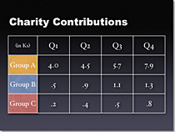
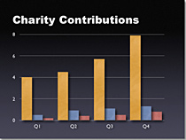
10.1.5 Principles of a good presentation
8. Use charts and tables appropriately
In general, tables are good for side-by-side comparisons of quantitative data. However, tables can lack impact on a visceral level. If you want to show how your contributions are significantly higher than two other parties, for example, it would be best to show that in the form of a bar chart (below, right).

Slide 19
10.1.5 Principles of a good presentation
Summary- A good presentation should have:
Font sizes that the audience can read from a distance.
Suitable charts and graphs with understandable labels.
High contrast between background color and text color.
Proper spelling and grammar.
Appropriate art and graphics to help convey your message.
A consistent and simple design. This can be achieved using a slide master.
Have good quality images that reinforce and complement your message. Ensure that your image maintains its impact and resolution when projected on a larger screen.
Summary- A good presentation should NOT have:
Not have unnecessary CAPITALISATION.
Not have distracting flashy transitions such as text fly-ins. These features may seem impressive at first, but are distracting and get old quickly.
Not have too many animations and sounds that could negatively impact the credibility of the presentation.
Not have too many words on each slide. and include only essential information.
Not have too many slides. Presenters who constantly “flip” to the next slide are likely to lose their audience. A good rule is one slide per minute.

Slide 20
10.1.5 Principles of a good presentation
Delivery Tips:
Know how to and practice moving forward AND backward within your presentation. Audiences often ask to see the previous screen again.
Have a Plan B in the event of technical difficulties. Remember that transparencies and handouts will not show animation or other special effects.
Practice with someone who has never seen your presentation. Ask them for honest feedback about colors, content, and any effects or graphical images you’ve included.

Slide 21



10.1.5 Principles of a good presentation
Delivery Tips (cont):
Do not read from your slides. The content of your slides is for the audience, not for the presenter.
Do not speak to your slides. Many presenters face the direction of their presentation rather than their audience.
Do not apologize for anything in your presentation. If you believe something will be hard to read or understand, don’t use it.

Slide 22
10.1.6 Features of a presentation software interface
Below is a screenshot of the PowerPoint 2007 interface with some common components labelled..

Slide 23
10.1.6 Features of a presentation software interface
Below are some of the unique features of presentation software
Animations: Visual effects on individual items on the slide.
Slide Show: display / projection of all the digital slides created, shown one after the other, or as set in a custom show.
Notes Area: Section which allows the speaker to keep notes for personal reference during the presentation.
Summary slide: One new slide with a list of all the titles of the slides in the presentation
Transition: Visual effects as one slide changes to another.

Slide 24
10.1.6 Features of a presentation software interface
Below are some of the unique features of presentation software
Slide Master: Manages layouts, effects, colors and fonts for all slides at once.
Graphs and Charts: You can add various types of graphics, such as bar charts, line charts, clip art, and photographs to your presentation.
The Pack and Go / Export Wizard leads you step-by-step through preparing your presentation delivery in various export formats.
Footers, & Slide Numbering: Allows you to specify customized footers that the presentation file will put at the top and bottom of every presentation. The presentation automatically keeps track of slide numbers so that the correct number appears on each slide.

Slide 25
10.1.7 Application areas of a presentation
Presentation software is commonly used in
Classes and lecture rooms for lesson delivery (in schools)
Conferences
Churches for displaying order of service, song lyrics and scriptures
Advertisement of goods and services on displays
Business / Board Meetings
QN: Identify any other areas where electronic presentations are used.

Slide 26
Sub Topic 10.2: Working with Presentation Software
Sub topic Objectives:
10.2.1 Opening and closing of presentation software
10.2.2 Creation of slides in a presentation
10.2.3 Creating presentations based on different appropriate templates
10.2.4 Saving presentations in different formats

Slide 27
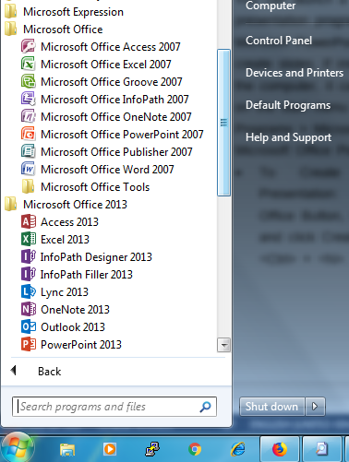
10.2.1 Opening and closing of presentation software
You can launch a presentation program like Microsoft PowerPoint to create slides. If installed on the computer, it can be found on the start menu > All Programs > Microsoft Office > Microsoft Office PowerPoint.
To Create a New Presentation: Click the Office Button, select New, and click Create, or press <Ctrl> + <N>.

Slide 28
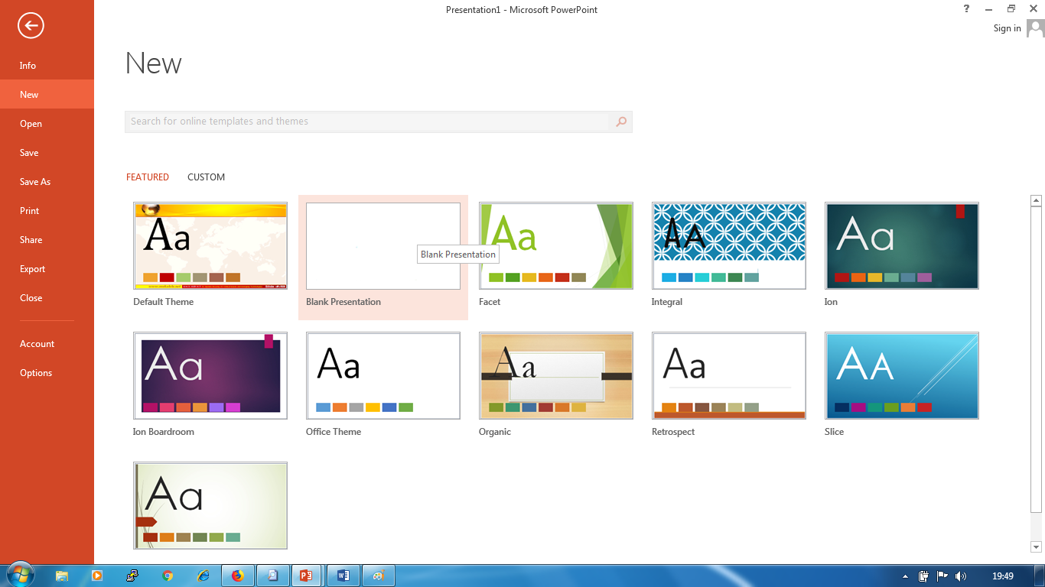
10.2.1 Opening and closing of presentation software

Slide 29
10.2.1 Opening and closing of presentation software
To Open an existing Presentation: Click the Office Button and select Open, or press <Ctrl> + <O>.
To Save a Presentation: Click the Save button on the Quick Access Toolbar, or press <Ctrl> + <S>.
To Save a Presentation with a Different Name: Click the Office Button, select Save As, and enter a new name for the presentation.
To Close a Presentation: Click the File/ Office Button and select Close, or press <Ctrl> + <W>.

Slide 30
10.2.2 Creation of slides in a presentation
To create a new slide within Slide view, follow these steps:
1. Click an existing slide in the thumbnail pane.
2. Click the Home tab.
3. Click the New Slide icon in the Slides group.
PowerPoint inserts your new slide after the slide you selected in Step 1.
To delete a slide, follow these steps:
1. In the thumbnail pane, click the slide that you want to delete.
2. Press the Delete key.
PowerPoint deletes your chosen slide.

Slide 31
10.2.3 Creating presentations based on different appropriate templates
Each time you create a new file, you have the option of choosing different types of templates that are already formatted and designed for specific purposes, such as a corporate slide-show presentation, as shown in the figure.

Slide 32
10.2.3 Creating presentations based on different appropriate templates
To create a new file, follow these steps:
1. Click the File tab.
2. Click New. A list of templates appears.
3. Double-click the template you want to use.
Office creates a new file based on your chosen template.
NB: For some templates, you may need internet connectivity to access the templates from Microsoft’s website.

Slide 33
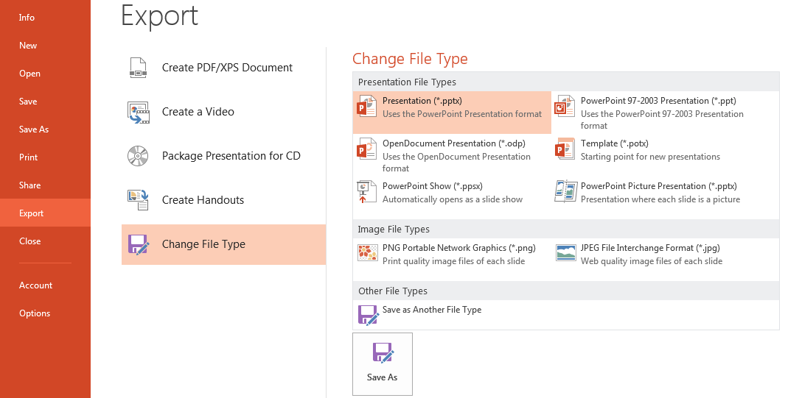
10.2.4 Saving presentations in different formats
You can save your presentation in different formats such as PDF, Video, Package Presentation for CD, Slides as Images (ie PNG or JPG), and other file types (with extensions .pptx, .ppt, .potx ,.pps, etc). 1. Click the File tab. 2. Click Export. The middle pane displays different formats.

Slide 34
Sub Topic 10.3: Developing a Presentation
Sub topic Objectives:
10.1 Presentation views:
using different presentation views: -normal view, -slide sorter, view, -slide show view
changing between presentation views.
10.2 Slide design:
choosing most appropriate slide layout.
copying, moving slide(s) within presentation or between presentations.
deleting slides.
10.3. Slide master
Formatting slide: changing background on specific/all slides.
inserting footer on specific slides, all slides in presentation.
editing slides through slide master.
setting automatic slide numbering, automatic dates, non-updating dates into footer of slide master

Slide 35
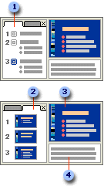
10.3.1 Presentation views
PowerPoint has four main views: Normal view, Slide Sorter view, Notes Page view, and Slide Show view.
Normal view is the main editing view, where you write and design your presentation. This view has four working areas:
1. Outline tab (shows slide text in outline form)
2. Slides tab (shows slide thumbnails)
3. Slide pane (shows a large view of current slide)
4. Notes pane (for private speaker notes)

Slide 36
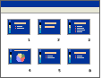
10.3.1 Presentation views
Slide Sorter view. In the slide sorter view, you can see the thumbnails of all the slides in the presentation to easily rearrange them.
To go to slide sorter view, Click View > in the Presentation Views group > click Slide Sorter.

Slide 37
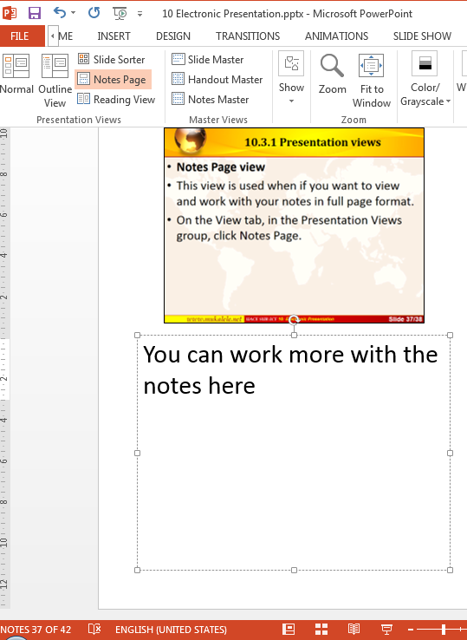
10.3.1 Presentation views
Notes Page view
This view is used when if you want to view and work with your notes in full page format.
On the View tab, in the Presentation Views group, click Notes Page.
Notes:
You can work more with the notes here

Slide 38
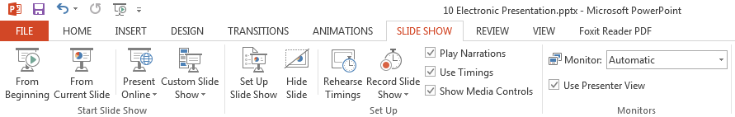
10.3.1 Presentation views
Slide Show: Projects all the slides in full screen view, shown one after the other, or as set in a custom show.
You can press F5 to launch the slide show from beginning or Shift+F5 to start from current slide. ( Or use buttons under Slide Show tab > in the Start Slide Show group > )
You can also use the buttons on the bottom bar located before the zoom slider to change between the various presentation views.

Slide 39
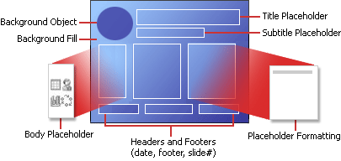
10.3.2 Slide design
A slide is designed by choosing an appropriate slide layout for it first, then adding necessary content and formation. You can use layouts to arrange objects and text on a slide. The following diagram shows all of the layout elements that you can include on a PowerPoint slide.

Slide 40
10.3.2 Slide design
Placeholders are Boxes with dotted or hatch-marked borders that are part of most slide layouts. These boxes hold title and body text or objects such as charts, tables, and pictures.
A layout defines positioning information for content that will later appear on a slide. Layouts contain placeholders which in turn hold text, such as titles and bulleted lists, and slide content such as SmartArt graphics, tables, charts, pictures, shapes, and clip art.
While you can add text and object placeholders to a layout or slide master, you cannot add placeholders directly to a slide.

Slide 41
10.3.2 Slide design
Under the Home Tab (Slides group), PowerPoint includes some built-in, standard layouts , or you can create custom layouts that meet your specific organizational needs.

Slide 42
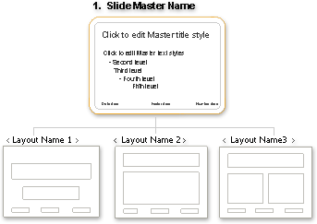
10.3.3 Slide master
A slide master controls the general layout and appearance of many slides in a presentation.
The following picture shows a single slide master that contains three layouts.

Slide 43
10.3.3 Slide master
A presentation can contain one or more slide masters which can be applied to different slides.
Each slide master contains one or more layouts, which make up a template saved as a template file (.potx) .
Each template can contain theme information, such as color, effects, fonts, slide background style, and default information describing how the theme and other formatting information are applied to the content in your slides.

Slide 44
10.3.3 Slide master
How Edit a slide master
On the View tab, in the Presentation Views group, click Slide Master.
If you want to remove an unwanted, default placeholder, click the border of the placeholder, and then press DELETE.
If you want to add a placeholder, do the following:
Click a thumbnail slide layout below the slide master that you added.
On the Slide Master tab, in the Master Layout group, click the arrow next to Insert Placeholder, and then click a placeholder.
Click a location on the slide master, and then drag to draw the placeholder.
Tip: To resize a placeholder, drag one of its corner borders.
You can also apply suitable formatting and add graphics and images to the slide master and alter its layout.

Slide 45
10.3.3 Slide master
Modifying Footers, Dates, Slide Numbers using the Slide Master
On the slide master, you can set/modify automatic slide numbering, dates, footer, etc by placing / manipulating the various placeholders on the slide master.
To resize a placeholder, click the placeholder you want to change, point to one of its sizing handles, and when the pointer becomes a two-headed arrow, drag the handle.
To reposition a placeholder, click the placeholder you want to change, point to one of its borders, and when the pointer becomes a four-headed arrow, drag the placeholder to a new position.
To change the font, size, case, color, or spacing for text within a placeholder, select the text, and then in the Font group, click the options that you want.

Slide 46
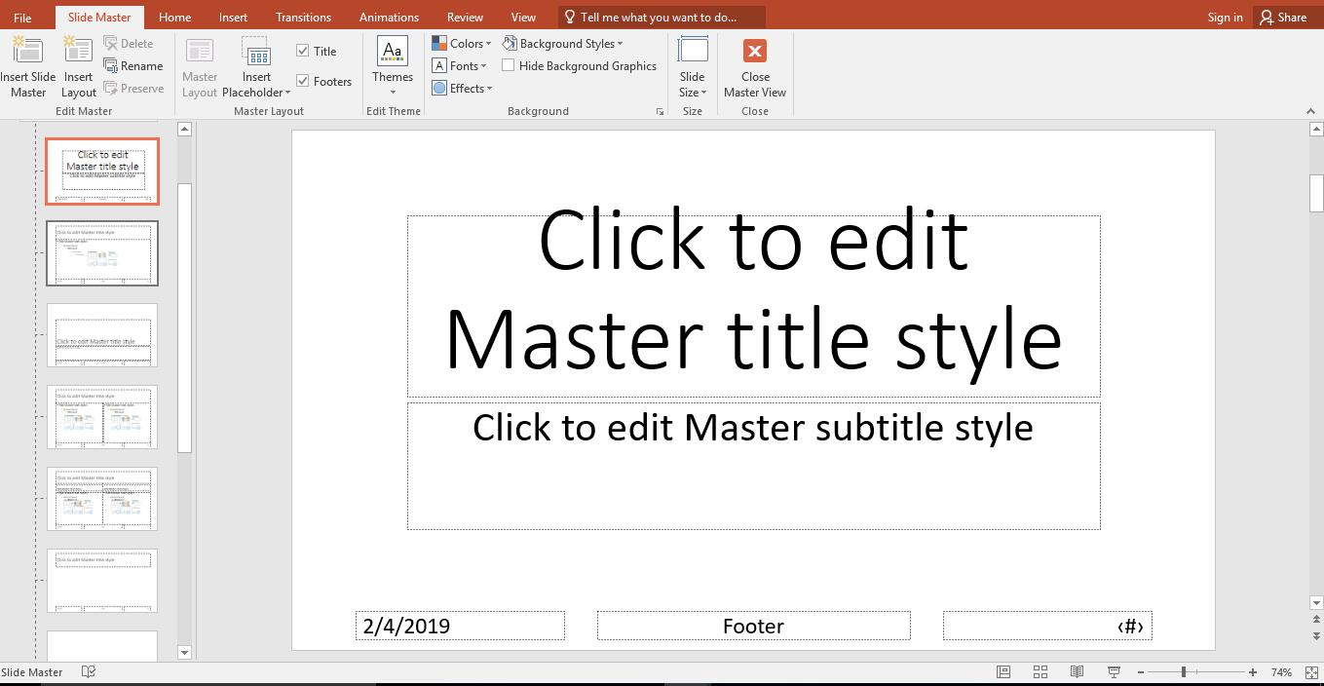
10.3.3 Slide master
Modifying Footers, Dates, Slide Numbers using the Slide Master
Note: To exit master view, on the Slide master tab, in the
Close group, click Close Master View.

Slide 47
Sub Topic 4: Charts
Sub topic Objectives:
creating a chart from data entered within a slide in a presentation.
importing data from other applications such as spreadsheets to create charts.
importing charts from some applications.
identifying chart types of a presentation software.
inserting an organization chart.
modifying an organization chart.

Slide 48
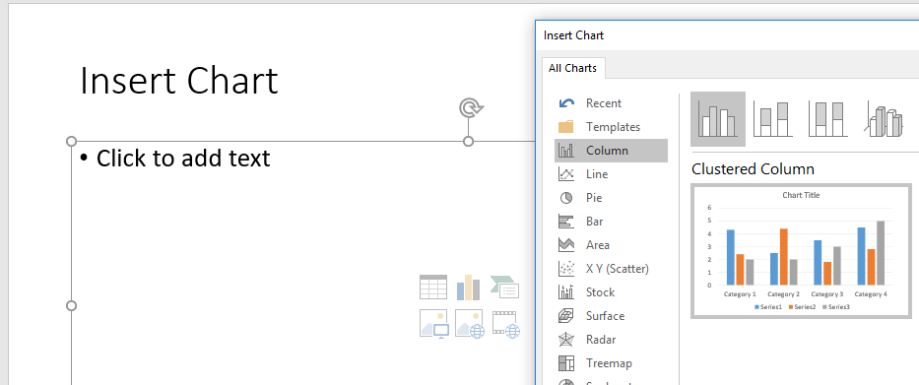
10.4.1 Creating Charts
To create a chart:
In the PowerPoint working window / content placeholder, click the Insert chart icon to launch the Insert Chart Dialog box, or Click on Insert Menu>Chart.

Slide 49
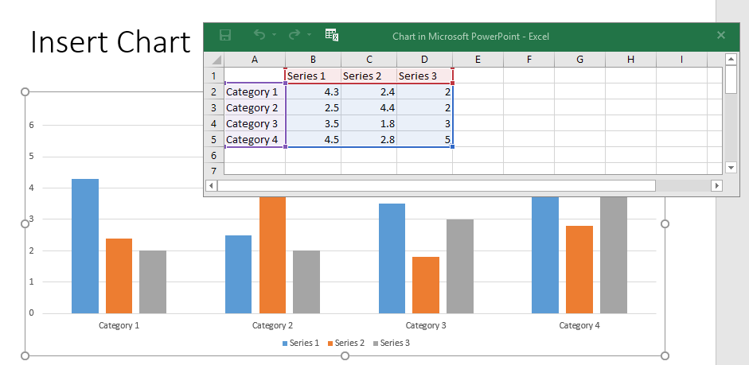
10.4.1 Creating Charts
After selecting your desired chart type, PowerPoint activates a data worksheet with labels and numbers. Change these labels and numbers to reflect your data.

Slide 50
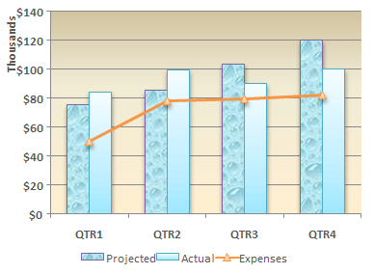
10.4.1 Creating Charts
If you want to change a column chart to a horizontal bar chart, choose that chart type from the Chart Type tool on the toolbar.

Slide 51
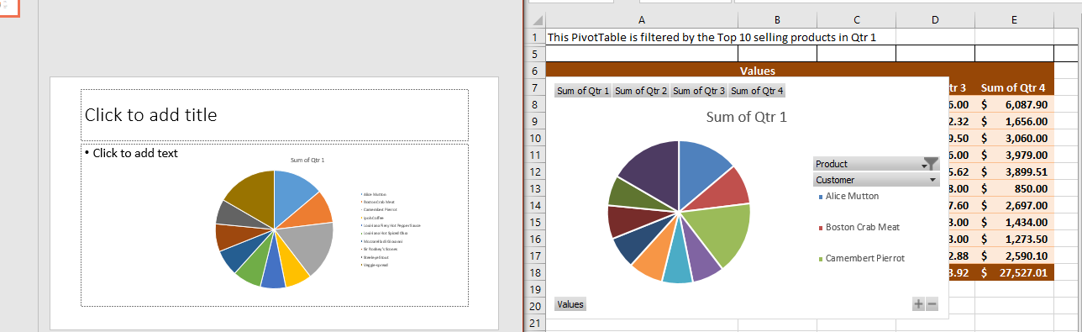
10.4.2 Importing data/charts from other applications such as spreadsheets.
PowerPoint is compatible with charts created by other Microsoft Office packages like Excel and Word.
Simply copy the existing chart and paste it within the slide.
You can also import external data by simply copying and pasting it in the chart data worksheet and then editing it accordingly.

Slide 52
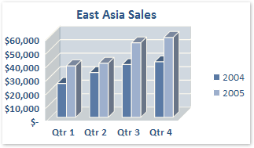
10.4.3 Chart types of a presentation software
There are numerous types of charts to help you display data in ways that are more meaningful to your audience as listed below:
Column charts are useful for showing data changes over a period of time or for illustrating comparisons among items.
Column charts subtypes are Clustered, Stacked, 3-D column, Cylinder, cone, and pyramid

Slide 53
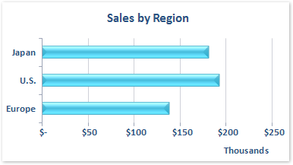
10.4.3 Chart types of a presentation software
Bar charts
Data that is arranged in columns or rows on a worksheet can be plotted in a bar chart. Bar charts illustrate comparisons among individual items.
Bar chart subtypes include:
Clustered bar and clustered bar in 3-D
Stacked bar and stacked bar in 3-D
100% stacked bar
Horizontal cylinder, cone, and pyramid

Slide 54
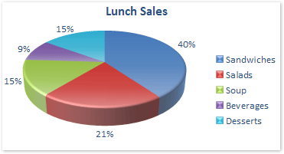
10.4.3 Chart types of a presentation software
Pie charts: Pie charts show the size of items in one data series, proportional to the sum of the items. The data points in a pie chart are displayed as a proportion of the whole pie.
Pie chart subtypes include:
Pie and pie in 3-D
Pie of pie and bar of pie
Exploded pie and exploded pie in 3-D

Slide 55
10.4.3 Chart types of a presentation software
Consider using a pie chart when:
You only have one data series that you want to plot.
None of the values that you want to plot are negative.
Almost none of the values that you want to plot are zero values.
You don't have more than seven categories.
The categories represent parts of the whole pie.

Slide 56
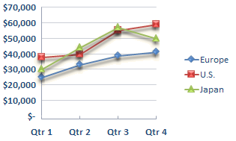
10.4.3 Chart types of a presentation software
Line charts are ideal for showing trends in data at equal intervals.
Line charts have the following chart subtypes: Line with markers , Stacked line and stacked line with markers, 100% stacked line, 3-D line
You should use a line chart if your category labels are text, and are representing evenly spaced values such as months, quarters, or fiscal years.

Slide 57
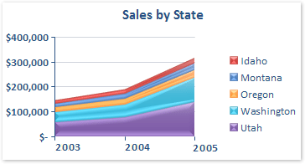
10.4.3 Chart types of a presentation software
Area charts
Area charts emphasize the magnitude of change over time, and can be used to draw attention to the total value across a trend. E.g. , data that represents profit over time can be plotted in an area chart to emphasize the total profit
Bar chart subtypes include:
Area and area in 3-D
Stacked area and stacked area in 3-D
100% stacked area
3-D area

Slide 58
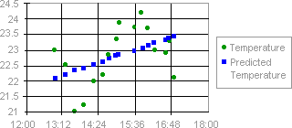
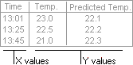
10.4.3 Chart types of a presentation software
XY (scatter) charts
Scatter charts show the relationships among the numeric values in several data series, or plots two groups of numbers as one series of xy coordinates.
Scatter chart subtypes include:
Scatter with smooth lines and scatter with smooth lines and markers
Scatter with only markers
Scatter with straight lines

Slide 59
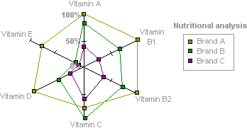
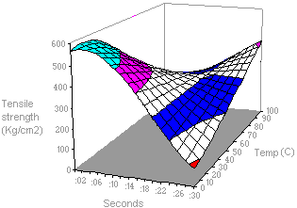
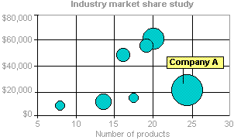
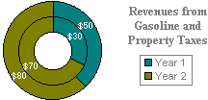
10.4.3 Chart types of a presentation software
Other chart type include:
Radar charts
Surface charts
Bubble charts
Doughnut charts

Slide 60
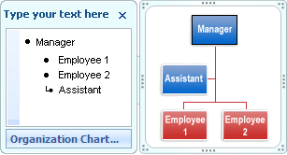
10.4.4 Organization charts
An organization chart graphically represents the management structure of an organization, such as department managers and all employees within a company.
To create an organization chart, Go to Insert menu> SmartArt> Hierarchy then choose Organization Chart

Slide 61
10.4.4 Organization charts
To create an organization chart quickly and easily, you can type or paste text in your organization chart and then have the text automatically positioned and arranged for you.
Although you can use other hierarchy layouts to create an organization chart, the assistant shape and the hanging layouts are available only with organization chart layouts.
To quickly add a designer-quality look and polish to your SmartArt graphic, you can change the colors or apply a SmartArt Style to your organization chart. You can also add effects, such as glows, soft edges, or 3-D effects. In PowerPoint presentations, you can animate your organization chart.

Slide 62
Sub Topic 5: Graphical Objects
Sub topic Objectives:
identifying different types of graphics (ClipArt, picture, auto shapes) that can be used in presentation software.
inserting the different types of graphics on a slide.
manipulating the position and size of the graphic and organising graphics on a slide.
applying shape effects on graphics on the slide.
inserting text boxes on a slide.

Slide 63
10.5.1 Different types of graphics that can be used in presentation software
These Include:
ClipArt,
pictures,
auto shapes (lines, polygons, arrows flow charts, etc)
WordArt,
Charts
Smart Art
Button and Action buttons
Videos, etc
PowerPoint has a set of drawing tools used to place lines, shapes, figures, WordArt, and text on a slide. PowerPoint's drawing tools are similar to drawing tools in other graphics programs. To use these tools, make sure you are in Slide View.

Slide 64
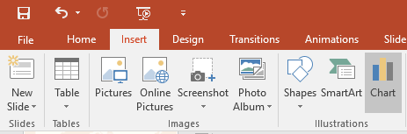
10.5.2 Inserting the different types of graphics on a slide
To Insert a Picture: Click the Insert tab on the Ribbon and click the Picture button in the Illustrations group. Browse to the picture you want to insert and click Insert.
To Draw a Shape: Click the Insert tab on the Ribbon, click the Shapes button in the Shapes group, and select the shape you want to insert. Then, click where you want to draw the shape and drag until the shape reaches the desired size. Hold down the <Shift> key while you drag to draw a perfectly proportioned shape or straight line.

Slide 65
10.5.3 Manipulating and organizing graphics on a slide
To Format an Object: Double-click the object and use the commands located on the Format tab.
To Move an Object: Click the object and drag it to a new location. Release the mouse button when you’re finished.
To Resize an Object: Click the object to select it, click and drag one of its sizing handles (0), and release the mouse button when the object reaches the desired size. Hold down the <Shift> key while dragging to maintain the object’s proportions while resizing it.
To apply advanced effects, right click and select “Format …” then use the options in the Format task pane.
To Delete an Object: Select the object and press the <Delete> key.

Slide 66
10.5.4 Inserting text boxes on a slide
You can use text boxes to place text anywhere on a slide, such as outside a text placeholder.
For example, you can add a caption to a picture by creating a text box and positioning it near the picture.
Also, a text box is handy if you want to add text to a shape, but you don't want the text to attach to the shape.
You can add a border, fill, shadow, or three-dimensional (3-D) effect to text in a text box.

Slide 67
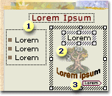
10.5.4 Inserting text boxes on a slide
To add a text box:
On the Insert tab, in the Text group, click Text Box.
Click the slide, and then drag the pointer to draw the text box.
Click inside the text box, and then type or paste the text.
NB: You can add text to the following areas in a slide:
Placeholder
Shape
Text box

Slide 68

Sub Topic 6: Presentation Output
Sub topic Objectives:
Using transitional effects
Using animation effects
Adding presenter notes on a slide.
Navigation:
creates links between slides and other files.
re-arranging slides.
Checking spelling.
saving a presentation in appropriate output formats.
choosing printer options and printing a presentation.

Slide 69
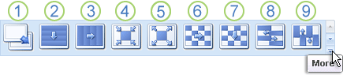
10.6.1 Using transitional effects
Slide transitions are visual effects that occur in Slide Show view when you move from one slide to the next. You can control the speed of each slide transition effect, and you can also add sound. PowerPoint includes many different types of slide transitions, including (but not limited to) the following:
1 No transition 2. Blinds Horizontal, 3-Blinds Vertical, 4-Box In, 5-Box Out, 6-Checkerboard Across, 7-Checkerboard Down, 8-Comb Horizontal, 9-Comb Vertical, etc.
NB: To see more transition effects, on the transitions menu, click the More button, as shown in the diagram above.

Slide 70
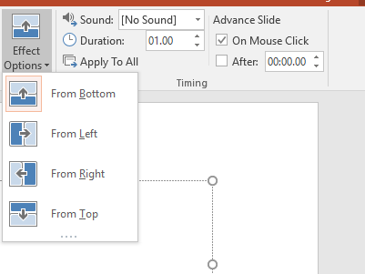
10.6.1 Using transitional effects
You can choose from the variations of a transitions from the available Effect Options.
To set the slide transition speed, in the Timing group, enter the duration you want.
To Add the same slide transition to all of the slides in your presentation, click Apply to All.

Slide 71
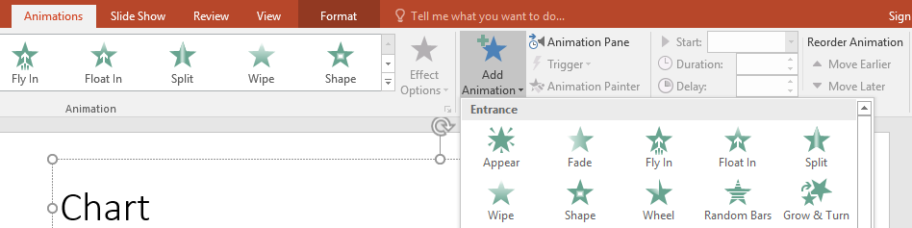
10.6.2 Using animation effects
Animations are motion effects applied to particular objects on a slide. You can animate the text, Charts, pictures, shapes, tables, SmartArt graphics, and other objects in your PowerPoint presentation. Effects can make an object appear, disappear, or move. They can make an object change size or color.
To apply an animation:
Select the object or text on the slide that you want to animate.
On the Animations tab of the ribbon, click Add Animation, and choose an animation effect to apply to the selected object.

Slide 72
10.6.2 Using animation effects
Animations are motion effects applied to particular objects on a slide. You can animate the text, Charts, pictures, shapes, tables, SmartArt graphics, and other objects in your PowerPoint presentation. Effects can make an object appear, disappear, or move. They can make an object change size or color.
To apply an animation:
Select the object or text on the slide that you want to animate.
On the Animations tab of the ribbon, click Add Animation, and choose an animation effect to apply to the selected object.

Slide 73
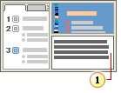
10.6.3 Adding presenter notes on a slide
You can use the notes pane in Normal view to write additional private notes about your slides, (which will not be seen by your audience.)
You can type and format your notes as you work in Normal view, but to see how your notes pages will be printed and to see the full effect of any text formatting, such as font colors, you have to switch to Notes Page view.
Notes area below the slide

Slide 74
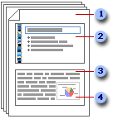
10.6.3 Adding presenter notes on a slide
The Notes page View shows an image of a slide, along with the notes that go with that slide.
Notes pages include your notes and each slide in the presentation.
Each slide is printed on its own notes page.
Your notes accompany the slide.
Data such as charts or pictures can be added to your notes pages.

Slide 75
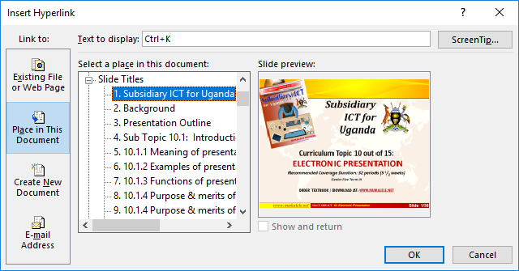
10.6.4 Navigation using action buttons and hyperlinks
A hyperlink is a connection from one slide to another slide in the same presentation or to a slide in another presentation, an e-mail address, a Web page, or a file.
You can create a hyperlink from text or from any object, such as a picture, graph, shape, or WordArt .
To create a hyperlink to a slide in the same presentation
In Normal view, select the text or the object that you want to use as a hyperlink.
On the Insert tab, in the Links group, click Hyperlink. Or press Ctrl+K.
Under Link to, click A place in this document, click the slide that you want to use as the hyperlink destination.

Slide 76
10.6.4 Navigation using action buttons and hyperlinks
An action button is a button that you can insert into your presentation and define hyperlinks for. Action buttons contain shapes, such as right and left arrows, and commonly understood symbols for going to home, next slides, etc and for playing movies or sounds on mouse-click or on mouse-over.
Action buttons are most commonly used for self-running presentations — for example, presentations that are shown repeatedly at a booth or kiosk.

Slide 77
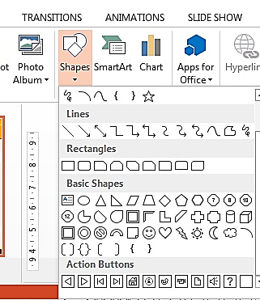
10.6.4 Navigation using action buttons and hyperlinks
On the Insert tab, click the arrow under Shapes and Scroll to the bottom, under Action Buttons, click the button that you want to add.
Click a location on the slide, and then drag to draw the shape for the button.
In the Action Settings dialog box, choose the behaviour of the action button when you click it or when you move the pointer over it, (this is under the Mouse Over tab.)

Slide 78
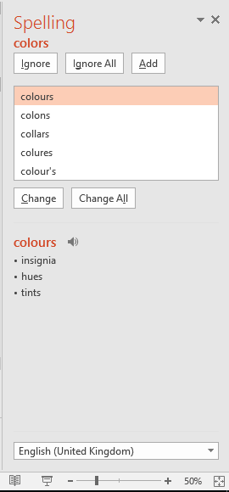
10.6.5 Checking spelling
To find and fix spelling mistakes in your document more quickly and easily, press F7 or on the Review tab, in the Proofing group, click the Spelling Icon.
If the program finds spelling mistakes, a dialog box or task pane is displayed, and the first misspelled word found by the spelling checker is selected. You decide how you want to resolve each error that the program finds.

Slide 79
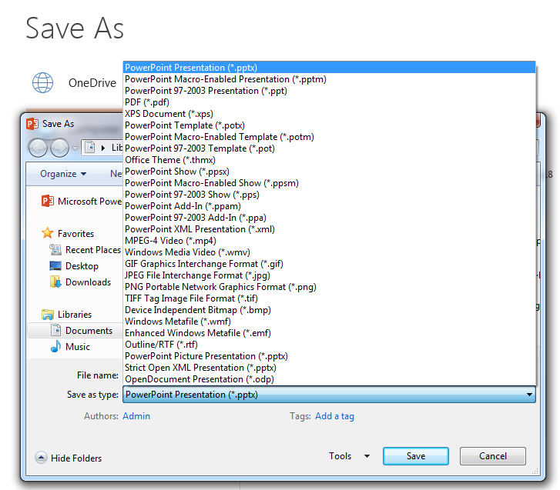
10.6.6 Saving a presentation in appropriate output formats
With Microsoft Office PowerPoint you can save your presentation into various file types as shown in the save as dialog box below:

Slide 80
10.6.6 Saving a presentation in appropriate output formats
Save As file type | Extension | Use to save
PowerPoint Presentation | .pptx | A PowerPoint 2007+ presentation
PowerPoint Macro-Enabled Presentation | .pptm | A presentation that contains Visual Basic for Applications (VBA) (Visual Basic for Applications (VBA): A macro-language version of Microsoft Visual Basic that is used to program Microsoft Windows-based applications and is included with several Microsoft programs.) code.
PowerPoint 97-2003 Presentation | .ppt | A presentation that you can open in PowerPoint 97 to Office PowerPoint 2003.
PDF Document Format | .pdf | A file format developed by Adobe that preserves document formatting.
XPS Document Format | .xps | A new Microsoft electronic paper format for exchanging documents in their final form.
PowerPoint Design Templates | .potx | A presentation as a template that you can use to format future presentations.

Slide 81
10.6.6 Saving a presentation in appropriate output formats
Save As file type | Extension | Use to save
PowerPoint Macro-Enabled Design Template | .potm | A template that includes pre-approved macros that you can add to a template to be used in a presentation.
PowerPoint 97-2003 Design Template | .pot | A template that you can open in PowerPoint 97 to Office PowerPoint 2003.
Office Theme | .thmx | A style sheet that includes definitions of a color theme, font theme, and effect theme.
PowerPoint Show | .pps; .ppsx | A presentation that always opens in Slide Show view rather than in Normal view.
PowerPoint Macro-Enabled Show | .ppsm | A slide show that includes pre-approved macros that you can run from within a slide show.
PowerPoint 97-2003 Show | .ppt | A slide show that you can open in PowerPoint 97 to Office PowerPoint 2003.

Slide 82
10.6.6 Saving a presentation in appropriate output formats
Save As file type | Extension | Use to save
Single File Web Page | .mht; .mhtml | A Web page as a single file with an .htm file and all supporting files, such as images, sound files, cascading style sheets, scripts, and more. Good for sending a presentation in e-mail
Web Page | .htm; .html | A Web page as a folder with an .htm file and all supporting files, such as images, sound files, cascading style sheets, scripts, and more. Good for posting on a site or editing with a web authoring software.
GIF (Graphics Interchange Format) | .gif | The GIF file format is limited to supporting 256 colors. GIF can be good for line drawings, black and white images, and small text that is only a few pixels high. GIF supports animation and transparent backgrounds.
JPEG (Joint Photographic Experts Group) FileFormat | .jpg | The JPEG file format supports 16 million colors and is best suited for photographs and complex graphics.

Slide 83
10.6.6 Saving a presentation in appropriate output formats
Save As file type | Extension | Use to save
PNG (Portable Network Graphics) Format | .png | PNG was approved as a standard by the World Wide Web Consortium (W3C) to replace GIF. PNG does not support animation as GIF does, and some older browsers do not support this file format.
TIFF (Tag Image File Format) | .tif | TIFF graphics can be any resolution, and they can be black and white, gray-scaled, or color.
Device Independent Bitmap | .bmp | A bitmap is a representation, consisting of rows and columns of dots, of a graphics image in computer memory. The value of each dot (whether it is filled in or not) is stored in one or more bits of data.
Outline/RTF | .rtf | A presentation outline as a text-only document tha provides smaller file sizes and the ability to share macro-free files with others who may not have the same version of PowerPoint or the operating system that you have.
PowerPoint slide | .sldx | An autonomous slide file.
MPEG 4 Video | .mp4 | A video file (Converts an automatically running presentation into a video)

Slide 84
10.6.7 Choosing printer options and printing a presentation
In PowerPoint, you can create and print slides, handouts, and notes pages.
Most presentations are designed to be presented in color, but slides and handouts are typically printed in black and white or shades of gray, also known as grayscale.
When you print in grayscale, color images are printed in variations of gray tones between black and white.

Slide 85
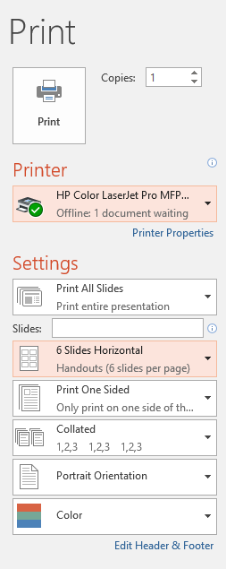
10.6.7 Choosing printer options and printing a presentation
Printing the slides
Click the Office Button or File Tab, and then click Print or Press Ctrl+P
In the settings section or Print Dialog, choose from the options
the printer,
whether you intend to print all slides or only the current slide,
choose Slides if you want full page slides or many slides per page (handouts), or notes pages or the outline view.
Also select from Color/Grayscale/Pure Black and White, and then click the Print button.

Slide 86
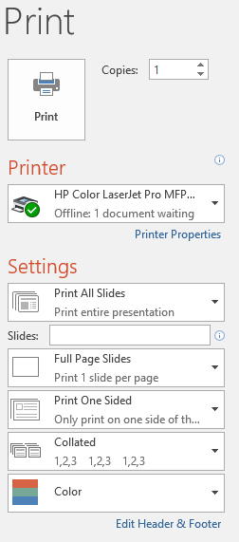
10.6.7 Choosing printer options and printing a presentation
Printing the slides
Click the Office Button or File Tab, and then click Print or Press Ctrl+P
In the settings section or Print Dialog, choose from the options
the printer,
whether you intend to print all slides or only the current slide,
choose Slides if you want full page slides. Other options are many slides per page (handouts), or notes pages or the outline view.
Also select from Color/Grayscale/Pure Black and White, and then click the Print button.

Slide 87
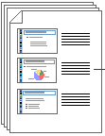
10.6.7 Choosing printer options and printing a presentation
An emphasis on printing as handouts
To save paper, most of the times the students are required to print handouts having many slides per sheet.
You can print your presentation in the form of handouts — with one, two, three, four, six, or nine slides on a page — that your audience can use to follow along as you give your presentation or keep for future reference.
The three-slides-per-page handout includes lined space for note taking by the audience.
You can also select a layout for your handouts in print preview.

Slide 88
Sub Topic 10.7: Slide Show
Sub topic Objectives:
10.7.1. Setting up a slide show to run manually or automatically.
10.7.2. Running a slide show from current slide.

Slide 89
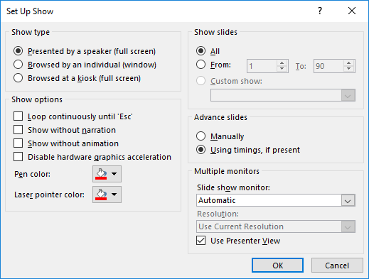
10.7.1 Setting up a slide show to run manually or automatically
Before delivering a presentation to an audience, we can specify / setup the show type, the transition looping, pen color, slide advance method monitors, etc. These options are under the Setup Show dialog box launched by clicking Slide Show Menu>Setup Slide Show)
Select Manually in order to run the slide show at your pace as a speaker, or Select to use timings, which need to be recorded using the Rehearse Timings feature also under the slide show menu, to enable automation.

Slide 90
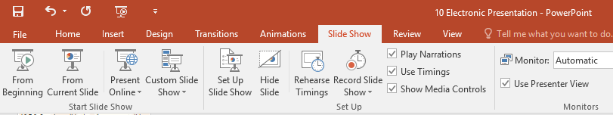
10.7.2 Running a slide show from current slide
In PowerPoint, we can use the options under the slide show tab, start slide show group to run a slide show of all slides available in a presentation or to create a custom show (A subset of slides in an existing presentation to be shown to a particular audience).
To show all slides in your presentation from the beginning, click Slide Show>From Beginning or press the F5 function key.
To run the slide show from the current position, you can click on Slide Show>From Current Slide or press Shift+F5 on the keyboard.
To start a custom slide presentation that derives from another PowerPoint presentation, click Custom Slide Show, and then click the presentation that you want to view as a custom show or click on New to make a new custom section of slides for the custom show.

Slide 91
10.8 Presentation projects for class presentation
Experience is the best teacher! You need to do lots of practice exercises to discover and gain more skills in word processing.
Some practical exercises are included in the Subsidiary ICT for Uganda book at the end of each practical chapter, but for more on the support files approach, practical questions, lab activities, and over twenty sets of standard full past papers and their support files, get a copy of the book entitled “FOR COMPUTER PRACTICAL APPLICATIONS LAB ACTIVITIES for Uganda” - Second Edition 2018 by Mukalele Rogers.

Slide 92
Subsidiary ICT for Uganda
End of Topic 10:
Electronic Presentation
Next Topic 11: Data Communication and Networking

